Slide 1

E-mail and SMTP
Name - Rajkumar Das
Roll - 261
Introduction
architecture
UA
MTA
SMTP
MAA
POP3
IMAP4
MIME
WBM
security

Slide 2
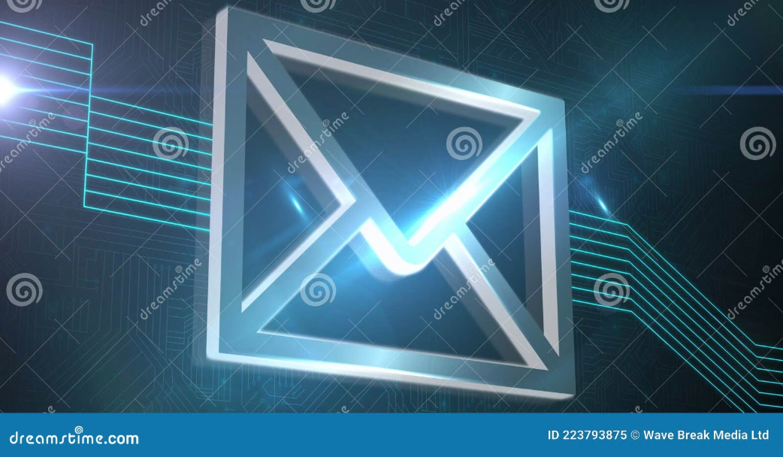
Introduction
What is E-mail?
E-mail (Electronic Mail) is a method of exchanging digital messages between people
using electronic devices over a network, primarily the Internet. It allows fast, reliable,
and cost-effective communication of text, documents, images, and multimedia.
Introduction
architecture
UA
MTA
SMTP
MAA
POP3
IMAP4
MIME
WBM
security

Slide 3
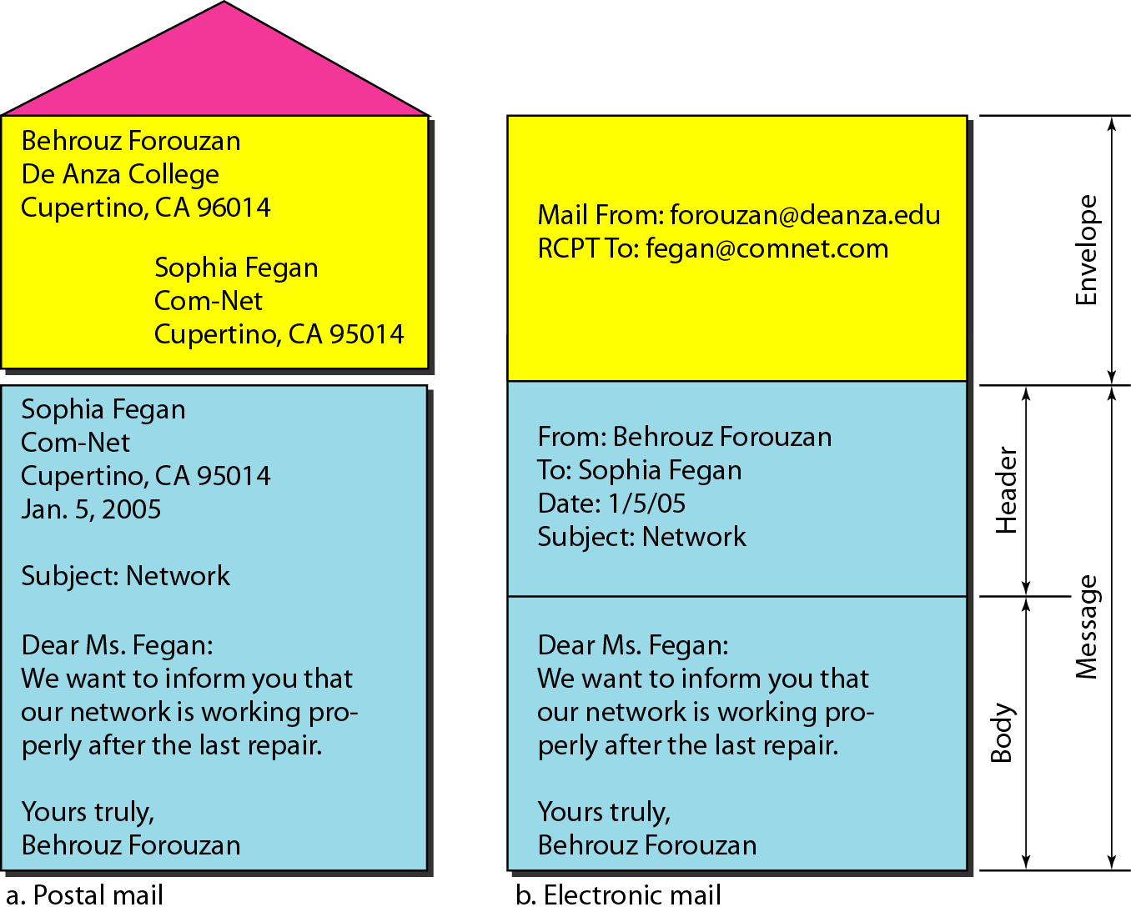
Mail Structure
Introduction
architecture
UA
MTA
SMTP
MAA
POP3
IMAP4
MIME
WBM
security

Slide 4
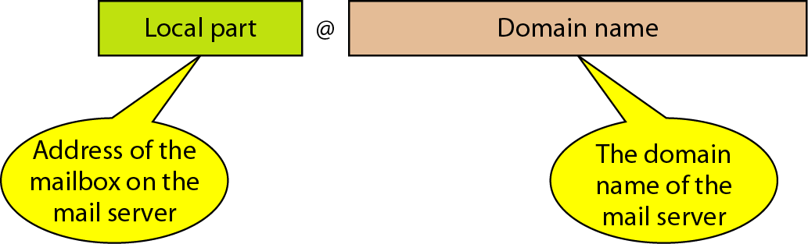
Address
Local Part:
Name of the user’s mailbox (where messages are stored).
Domain Name:
Identifies the mail server (or exchanger) responsible for receiving and sending e-mails.
Retrieved from DNS or can be a logical name (e.g., organization name).
Example:
rajkumar@gmail.com
rajkumar → Local part (user mailbox)
gmail.com → Domain name (mail server/organization)
Introduction
architecture
UA
MTA
SMTP
MAA
POP3
IMAP4
MIME
WBM
security

Slide 5
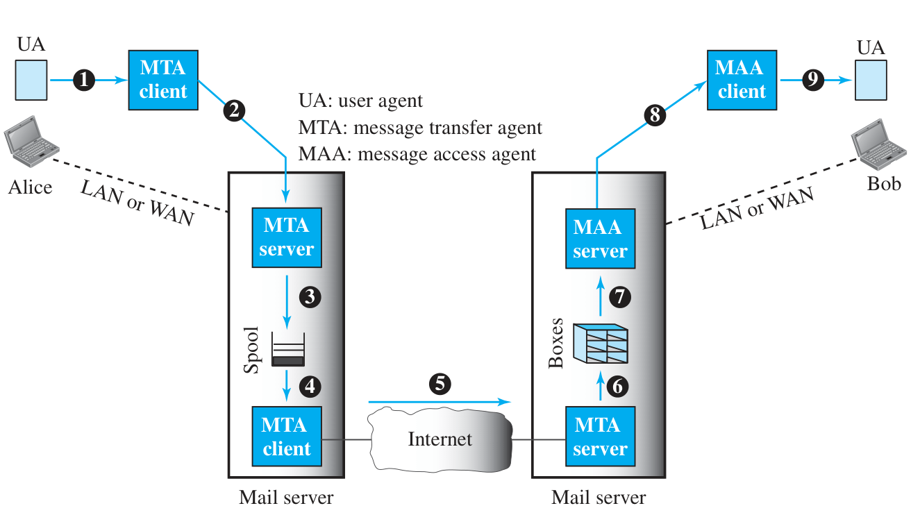
Architecture
Introduction
architecture
UA
MTA
SMTP
MAA
POP3
IMAP4
MIME
WBM
security

Slide 6
The User Agent (UA)
Role
Acts as the interface between the user and the e-mail system.
Allows users to compose, send, receive, read, reply to, forward, and organize e-mails.
Accepts messages from the user and passes them to the Message Transfer Agent (MTA).
Displays incoming messages to the user in a readable format.
Manages attachments, folders, and contacts.
Type
1. Command-Line Based UA:
Example: mail program on Unix/Linux systems.
Text-based interface, minimal features.
2. GUI-Based UA:
Example: Microsoft Outlook, Thunderbird.
User-friendly interface with rich features (drag-and-drop, formatting).
3. Web-Based UA:
Example: Gmail, Yahoo Mail
User-friendly interface with rich features.
Introduction
architecture
UA
MTA
SMTP
MAA
POP3
IMAP4
MIME
WBM
security

Slide 7
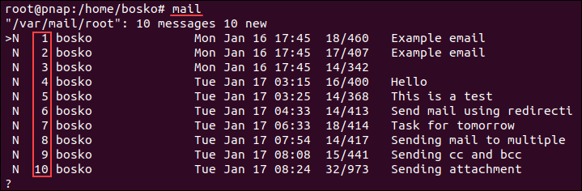
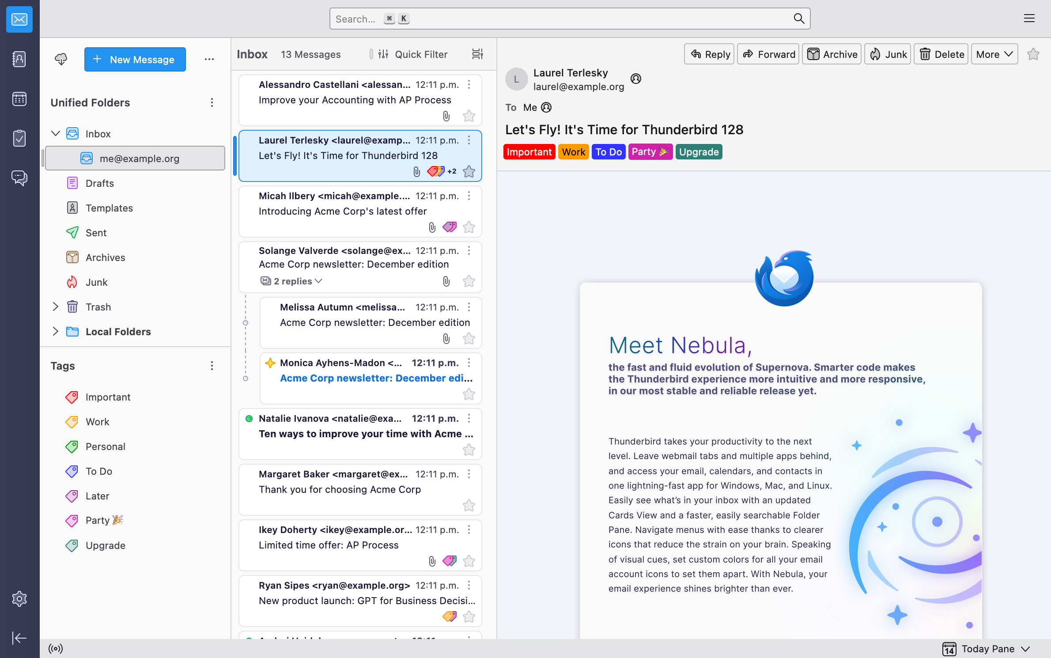
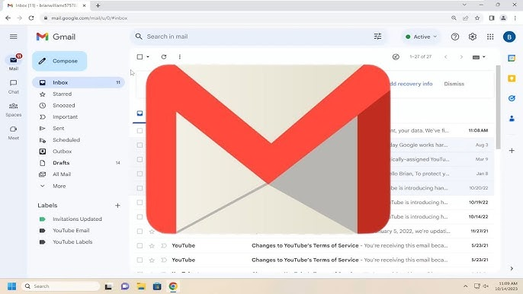
The User Agent (UA)
Command-line based
GUI based UA
Web based UA
Introduction
architecture
UA
MTA
SMTP
MAA
POP3
IMAP4
MIME
WBM
security

Slide 8
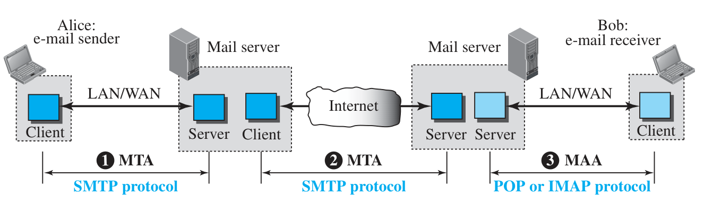
MTA(Message Transfer Agent)
The Message Transfer Agent (MTA) is responsible for transferring e-mails from the sender’s mail server to the recipient’s mail server. It works silently in the background without requiring user interaction. When a user sends an e-mail, the MTA accepts the outgoing mail from the User Agent (UA), determines the route to the destination, and relays the mail until it reaches the recipient’s MTA.
To perform this transfer, MTAs use the Simple Mail Transfer Protocol (SMTP).
Introduction
architecture
UA
MTA
SMTP
MAA
POP3
IMAP4
MIME
WBM
security

Slide 9
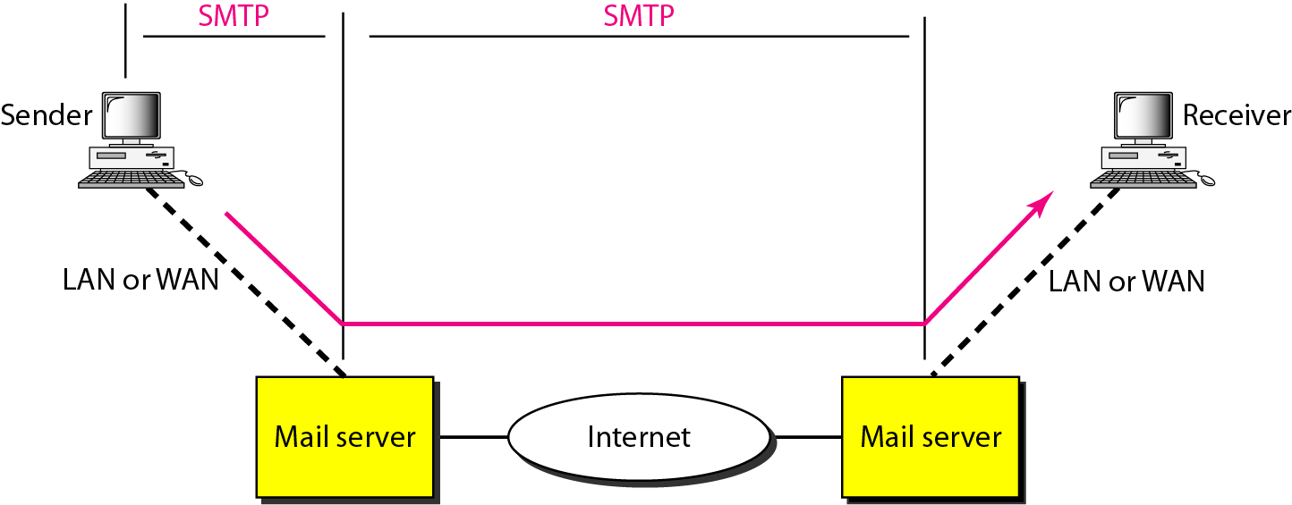
SMTP(Simple Mail transfer Protocol)
SMTP is a standard Internet protocol designed to send and relay e-mails. It is a push protocol, meaning it pushes e-mails from the sender’s server toward the receiver’s server. SMTP uses TCP port 25 for reliable communication and relies on commands like HELO, MAIL FROM, RCPT TO, and DATA to exchange messages between mail servers.
Introduction
architecture
UA
MTA
SMTP
MAA
POP3
IMAP4
MIME
WBM
security

Slide 10
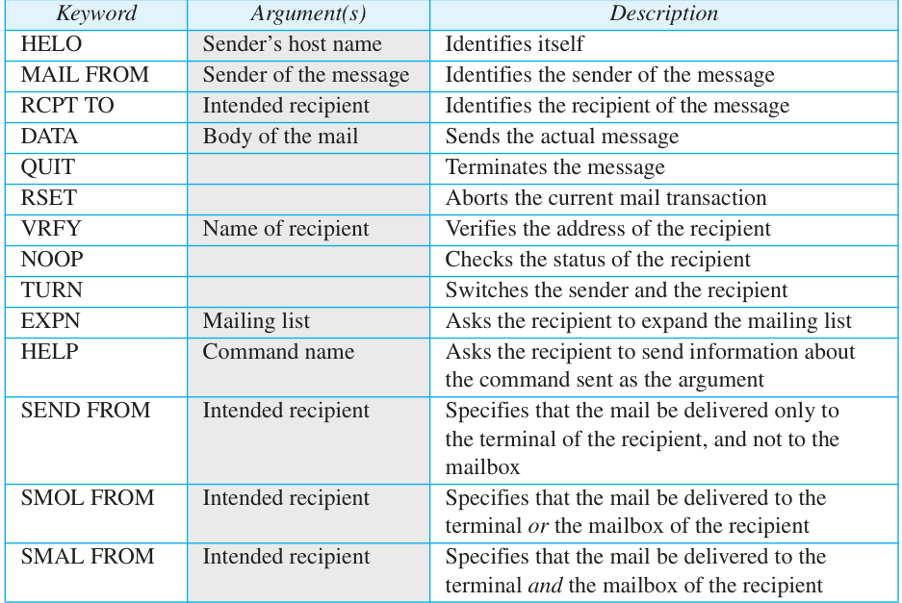
SMTP commands
Commands are sent from the client to the server.
Introduction
architecture
UA
MTA
SMTP
MAA
POP3
IMAP4
MIME
WBM
security

Slide 11
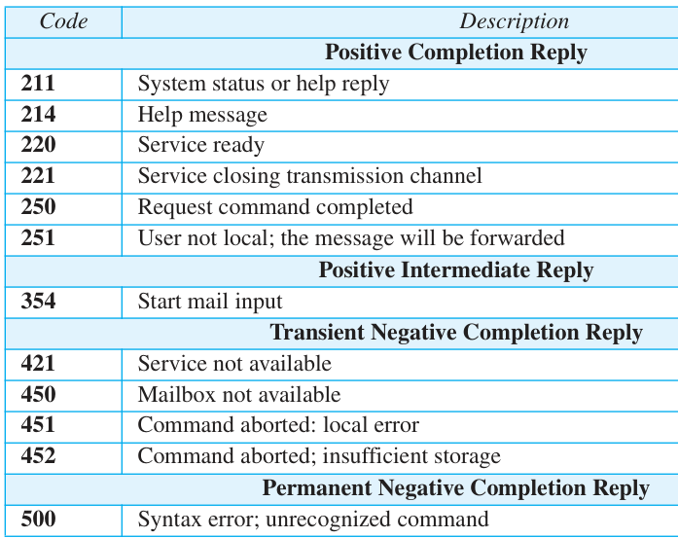
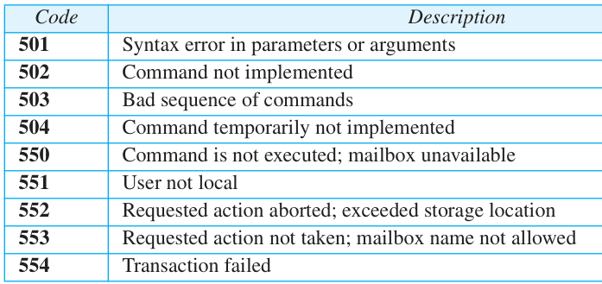
SMTP responses
Responses are sent from the server to the client. A response is a three-
digit code that may be followed by additional textual information.
Introduction
architecture
UA
MTA
SMTP
MAA
POP3
IMAP4
MIME
WBM
security

Slide 12
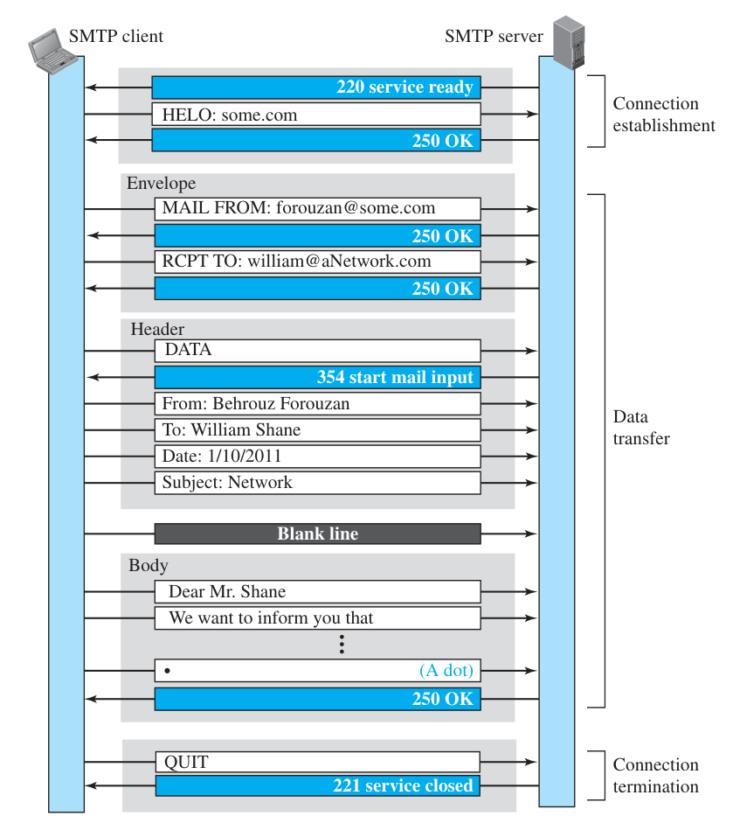
Mail transfer phrases
Mail transfer phrases
Connection Establishment
Data Transfer
Connection Termination
Introduction
architecture
UA
MTA
SMTP
MAA
POP3
IMAP4
MIME
WBM
security

Slide 13
Connection Establishment
After a TCP connection is made to port 25, the SMTP server begins the connection phase, which ensures both client and server are ready for communication.
Step 1:
Step 2:
The SMTP server sends code 220 (service ready) to indicate it is ready to receive mail. If unavailable, it sends code 421 (service not available).
The SMTP client sends a HELO message along with its domain name to introduce itself to the server.
Step 3:
The server responds with code 250 (request completed successfully) or another status code depending on the situation.
Introduction
architecture
UA
MTA
SMTP
MAA
POP3
IMAP4
MIME
WBM
security

Slide 14
Data transfer
Once the connection is established, the SMTP client and server exchange messages to deliver the email. The process involves eight steps:
Step 1:
Client sends MAIL FROM to introduce the sender’s address (used for error reporting).
Step 2:
Server responds with 250 (OK) to confirm.
Step 3:
Client sends RCPT TO with the recipient’s address.
Step 4:
Server responds with 250 (OK) to confirm (repeated for multiple recipients).
Step 5:
Client sends DATA command to start message transfer.
Step 6:
Server responds with 354 (Start mail input) indicating readiness.
Step 7:
Client sends the message content line by line, ending with a single period (.) on a separate line.
Step 8:
Server responds with 250 (OK) to confirm successful delivery.
Introduction
architecture
UA
MTA
SMTP
MAA
POP3
IMAP4
MIME
WBM
security

Slide 15
Connection Termination
After the message is successfully delivered, the SMTP client closes the session with the server.
Step 1:
The client sends QUIT command to indicate the end of communication.
Step 2:
The server responds with code 221 (service closing) or another appropriate code, confirming the termination.
Introduction
architecture
UA
MTA
SMTP
MAA
POP3
IMAP4
MIME
WBM
security

Slide 16
Introduction
architecture
UA
MTA
SMTP
MAA
POP3
IMAP4
MIME
WBM
security

Slide 17
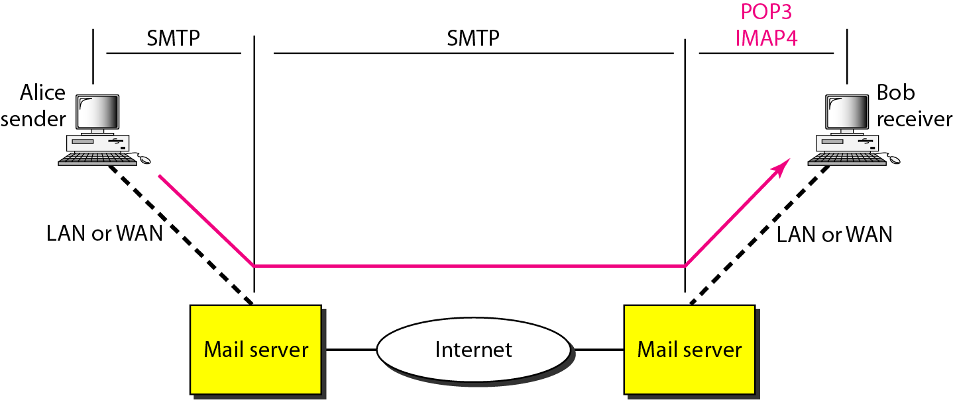
Message Access Agent(MAA)
The Message Access Agent (MAA) is responsible for retrieving e-mails from the recipient’s mail server and delivering them to the user’s device. Unlike SMTP, which pushes mail from the sender to the server, MAA works as a pull mechanism – the user’s device requests (pulls) the emails from the server whenever they want to check their inbox.
Two main protocols are used for this purpose: POP3 and IMAP4. POP3 is simple and allows users to download their messages,
Introduction
architecture
UA
MTA
SMTP
MAA
POP3
IMAP4
MIME
WBM
security

Slide 18
POP3(Post Office Protocol, v3)
POP3 is a simple, widely used mail access protocol that downloads emails from the server to the recipient’s computer. POP3 client software runs on the recipient’s device, while POP3 server software runs on the mail server.
How it works:
The client opens a connection to the server on TCP port 110.
Sends username and password to authenticate the mailbox.
Lists available messages and retrieves them one by one.
Modes of Operation:
Delete Mode: Emails are deleted from the server after downloading.
Best for users working from their primary computer where they save and organize mail locally.
Keep Mode: Emails remain on the server even after downloading.
Useful for users who need to access their email from multiple devices or a temporary location (like a laptop).
Introduction
architecture
UA
MTA
SMTP
MAA
POP3
IMAP4
MIME
WBM
security

Slide 19
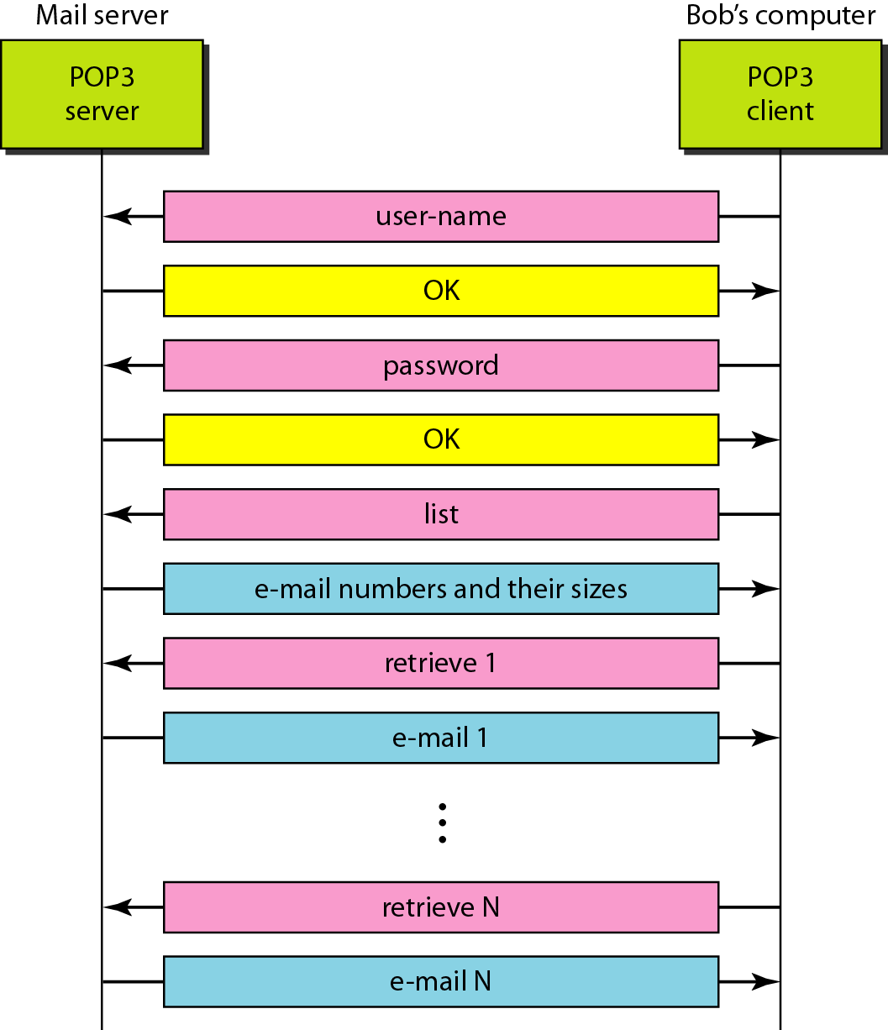
POP3 workflow
Client Request
Authentication:
List Messages:
Retrieve Messages:
Delete or Keep:
In Delete Mode, messages are removed from the server after downloading.
In Keep Mode, messages remain on the server for later access.
Close Connection:
The POP3 client on the user’s computer opens a connection to the mail server on TCP port 110.
The client sends the username and password to log in and access the user’s mailbox.
The server responds with a list of available emails in the mailbox.
The client downloads emails one by one to the local computer for offline access.
Once all messages are retrieved, the client closes the connection to the server.
Introduction
architecture
UA
MTA
SMTP
MAA
POP3
IMAP4
MIME
WBM
security

Slide 20
About IMAP4(Internet Mail Transfer Protocol v4)
What is IMAP4:
A powerful and feature-rich mail access protocol.(it uses 143 port or 993 port)
Allows users to manage and organize emails directly on the mail server.
Key Features:
View headers before downloading messages.
Search emails on the server for specific words/phrases before downloading.
Partial download of emails (helpful for large attachments or slow internet).
Create, delete, rename mailboxes/folders on the server.
Organize mail in a hierarchy of folders for better management.
Synchronizes across multiple devices (email stays on the server).
Why Use IMAP4:
Ideal for users accessing email from multiple devices (phone, laptop, PC).
Saves bandwidth and storage since emails stay on the server until needed.
Great for users who want to manage and organize mail without downloading everything.
Introduction
architecture
UA
MTA
SMTP
MAA
POP3
IMAP4
MIME
WBM
security

Slide 21
POP3 vs IMAP4
Feature | POP3 | IMAP4
Mail Storage | Downloads mail to client (often deleted from server) | Keeps mail on server, syncs with all devices
Access Mode | Offline (after download) | Online (real-time sync)
Folder Support | No folder management | Supports folder creation, deletion, organization
Header Preview | Not supported | Supported (view headers before downloading)
Partial Download | Not possible | Possible (download parts selectively)
Introduction
architecture
UA
MTA
SMTP
MAA
POP3
IMAP4
MIME
WBM
security

Slide 22
MIME protocol
Multipurpose Internet Mail Extensions
Problem with Traditional Email:
Can only send messages in 7-bit ASCII. No support for non-English languages (French, Chinese, etc.). Cannot send binary files, audio, video, or images.
Solution: MIME
A supplementary protocol for email. Converts non-ASCII data → ASCII before sending. Converts back to original data at the receiver side. Enables sending multimedia, documents, images, audio, video through email.
Introduction
architecture
UA
MTA
SMTP
MAA
POP3
IMAP4
MIME
WBM
security

Slide 23
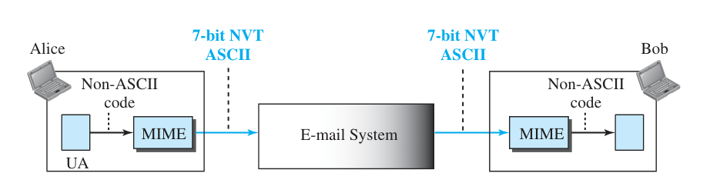
How it works
At Sender Side:
Non-ASCII data (image, audio, binary file) → Encoded into ASCII.
Data sent to MTA (Mail Transfer Agent) → Delivered via normal email system.
At Receiver Side:
ASCII data → Decoded back to original format (image/audio/video).
Key Idea:
MIME acts as a translator for data formats that basic SMTP cannot handle.
Introduction
architecture
UA
MTA
SMTP
MAA
POP3
IMAP4
MIME
WBM
security

Slide 24
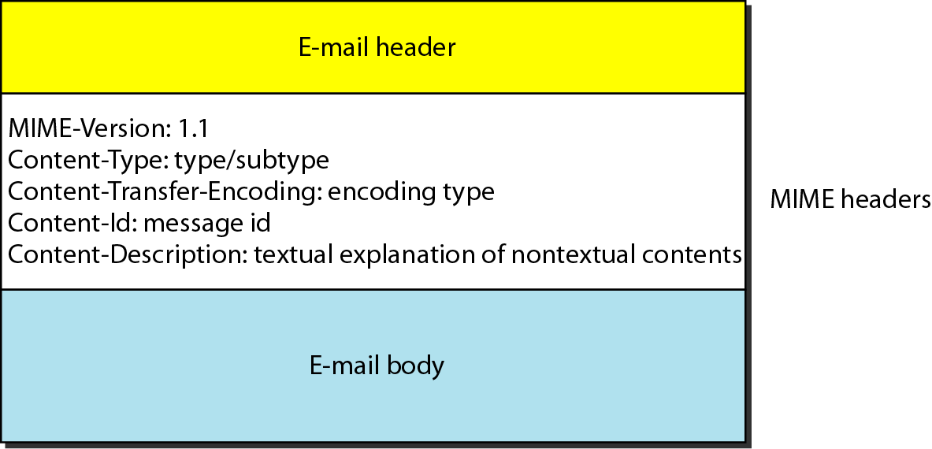
MIME header
Introduction
architecture
UA
MTA
SMTP
MAA
POP3
IMAP4
MIME
WBM
security

Slide 25
Data types and encoding types
Introduction
architecture
UA
MTA
SMTP
MAA
POP3
IMAP4
MIME
WBM
security

Slide 26
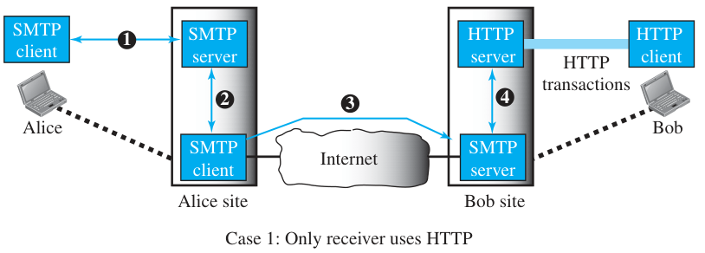
Web based mail
Some websites provide email service for free (e.g., Hotmail, Yahoo Mail, Gmail).
Users can send, receive, and manage email through a web browser (no separate mail client needed).
Instead of POP3 or IMAP4, email retrieval is done using HTTP.
Convenient for users who access email from multiple devices or public computers.
Case 1 – Traditional Sender, Webmail Receiver:
Alice (sender) → Mail sent from browser to sending mail server (SMTP).
Sending mail server → Transfers message to receiving mail server (SMTP).
Bob (receiver) → Opens browser → Sends HTTP request to webmail site.
Server verifies username/password → Sends list of emails in HTML format.
Bob can read, browse, and open emails one by one using HTTP transactions.
Introduction
architecture
UA
MTA
SMTP
MAA
POP3
IMAP4
MIME
WBM
security

Slide 27
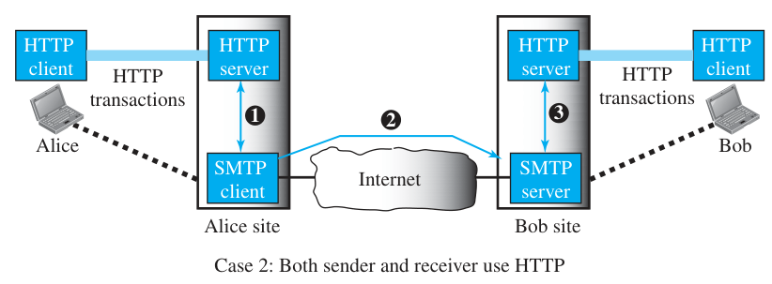
Web based mail
Case 2 – Both Users Use Webmail:
Alice sends email to web server via HTTP (includes Bob’s email address).
Alice’s web server → Passes message to SMTP client → Sends to Bob’s mail server.
Bob retrieves message through HTTP, just like Case 1.
Introduction
architecture
UA
MTA
SMTP
MAA
POP3
IMAP4
MIME
WBM
security

Slide 28
E-mail Security
Problem:
Basic email protocols (SMTP, POP3, IMAP4) do not provide security by default. Emails can be intercepted, modified, or spoofed during transmission.
Solution – Application Layer Security Protocols:
PGP (Pretty Good Privacy):
Provides encryption, authentication, and integrity for email messages.
Uses a combination of symmetric + public-key cryptography.
S/MIME (Secure/Multipurpose Internet Mail Extensions):
Based on MIME.
Supports digital signatures and encryption for secure email exchange.
Introduction
architecture
UA
MTA
SMTP
MAA
POP3
IMAP4
MIME
WBM
security

Slide 29
THANK YOU

